Slide 1
Agentic RAG Chatbot for Multi-Format Document QA using Model Context Protocol (MCP)
Akshith Sai Kondamadugu
akshithsai24@gmail.com

Slide 2
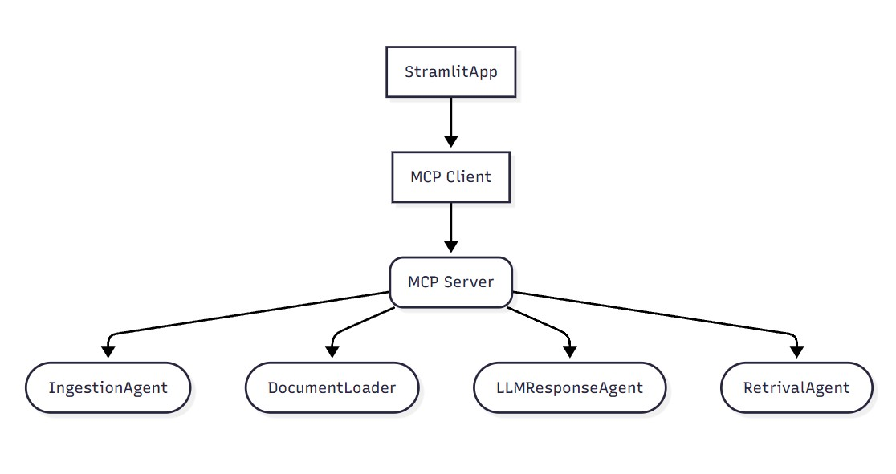
Agent-based architecture with MCP integration :

Slide 3
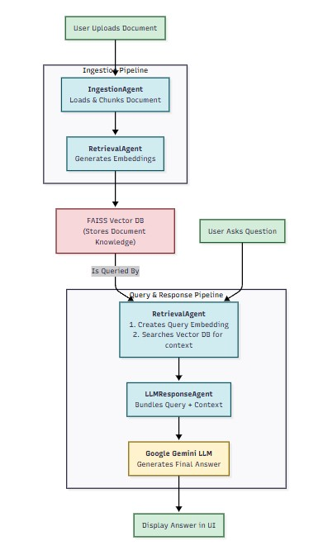
System flow diagram

Slide 4
Tech stack used
Frontend: Streamlit.
Backend & Orchestration: Python, MCP.
AI & RAG Framework: LangChain.
LLM & Embeddings: Google Gemini (gemini-2.0-flash, text-embedding-004) .
Vector Database: FAISS (Facebook AI Similarity Search).
Deployment: Docker and Render.

Slide 5
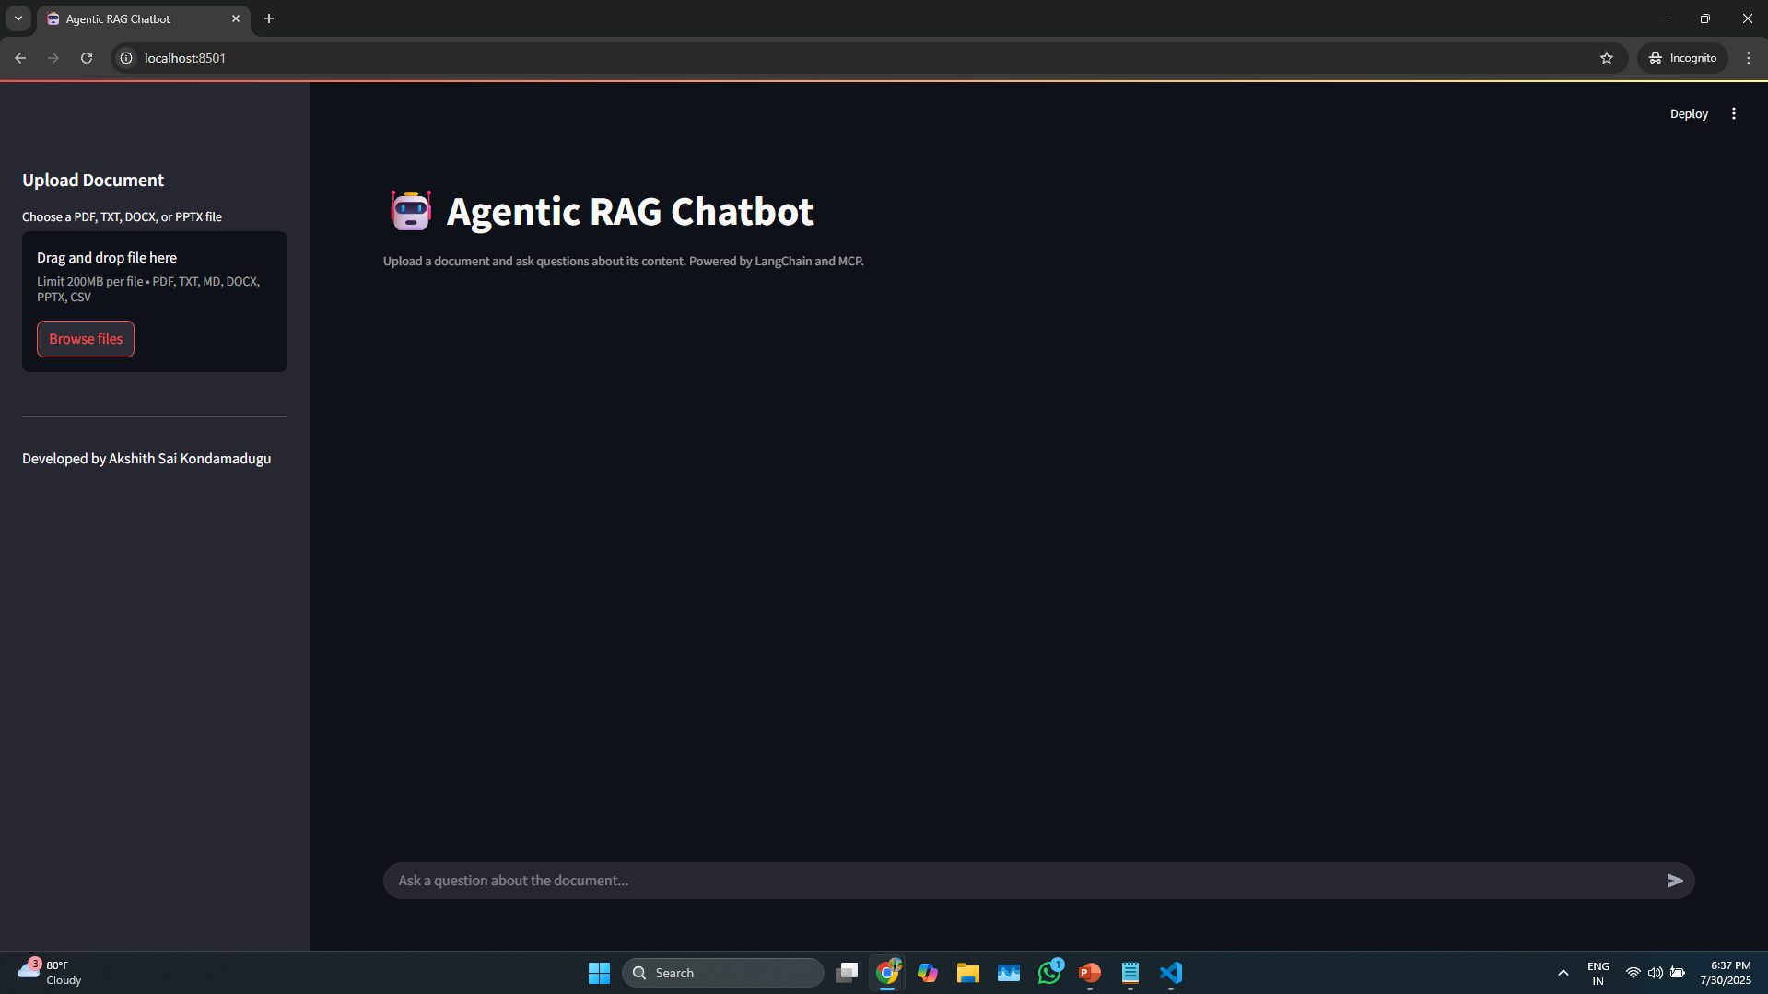
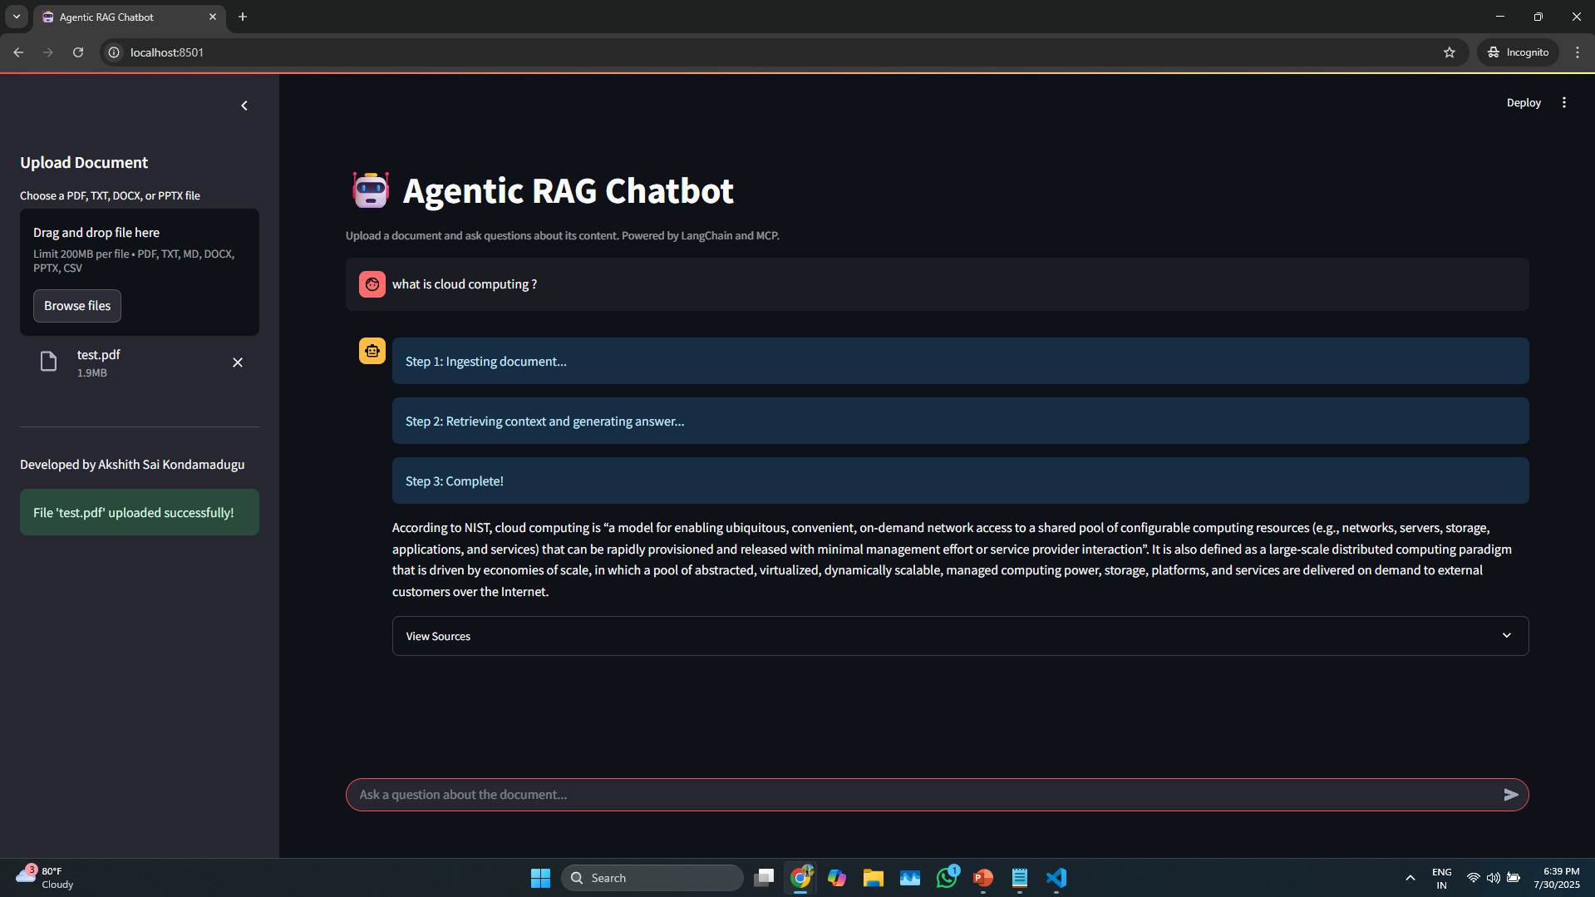
UI screenshots of working app

Slide 6
Challenges Faced while doing the project
As I am new to the Model Context Protocol(MCP), adapting to new protocol and integrating the traditional RAG to Agentic RAG with MCP was challenging.
Handling different document formats, such as .pptx and .docx.
Using a new UI framework (Streamlit) to collect files and send them to the MCP server
Handling Messages between the Agents.

Slide 7
Improvements for Future
Finding other ways to handle .pptx files.
Reduce Complexity Server Side.
Enhancement of User Interface Design.

Slide 8
Thank you
Akshith Sai Kondamadugu
akshithsai24@gmail.com

